Slide 1
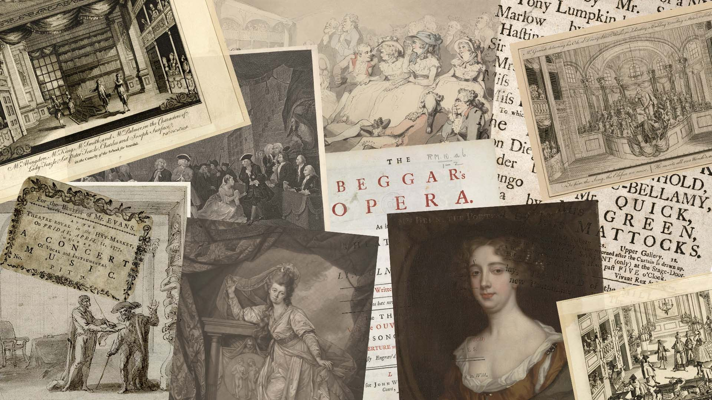
“Not acted these twenty years”
What Eighteenth-Century Theater Can Teach Us
about Sustaining Digital Humanities
Mattie Burkert (she, they)
Center for Print, Networks, and Performance
Carnegie Mellon University | November 7, 2024
Notes:
Thanks to Sede and Stephen, and to the Center for Print, Networks, and Performance, for inviting me to be here today. And thanks to Beryl, Eyone, and everyone else whose work behind the scenes has made this event possible.

Slide 2

Access Copies
tinyurl.com/burkert-cpnp
Notes:
An access copy of my slides is available at the QR code on my slide or at the link. The access version of my spoken remarks is in the notes pane.
I want to start off by acknowledging that this has been an historic, emotional, exhausting, and frankly gutting election week for many of us. I imagine that being here in Pennsylvania, you’ve experienced the past few days and weeks with a particular intensity. Admittedly, there is something fundamentally strange about the fact that we go on giving and attending talks about things like early modern studies when the immediate political and civic context feels so urgent. Yet I believe what I said to one of my grad seminar participants this week: this work is still, for me, part of the Work. The texts and histories I study give me so many ways of thinking about how those who came before negotiated the possibility spaces available to them, how they exercised agency within constraints, how they realized their commitments and reckoned with their complicities. And so, the show must go on; it can’t go on; it goes on.

Slide 3
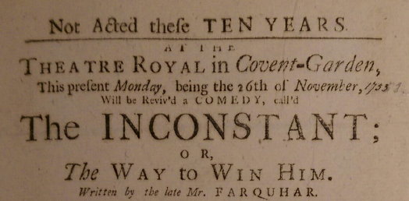
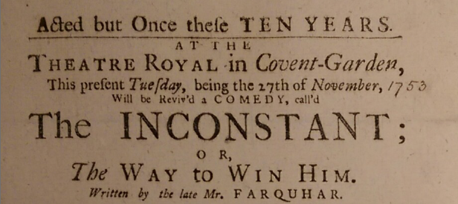
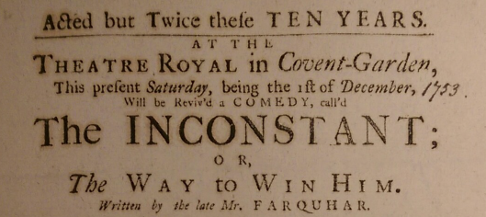
Playbills from Bill Vol G2 C85, Folger Shakespeare Library, Washington, D.C. Photos by Mattie Burkert, 2017
Notes:
The title of my talk today comes from a phrase that will be familiar to anyone who has worked with eighteenth-century playbills: “Not acted these [however many] years.” This was a common headline on the full-page advertisements for upcoming performances that were posted up around London and reproduced in the daily periodicals. Then, as now, remakes of established properties were good business – so much so that the selling point gets stretched almost to the point of absurdity as some of these performance runs go on: “Not acted these Ten Years;” the next night, “Acted but once these Ten Years;” and a week later, “Acted but Twice these Ten Years.”

Slide 4
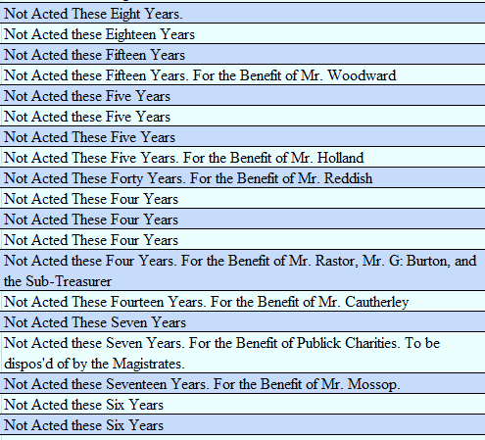
Notes:
I did not cherry-pick those images; variations on the phrase are ubiquitous, as suggested by this screengrab from a dataset of several hundred playbills Mark Vareschi and I analyzed in an article published in Theatre Journal.
Link to dataset: https://jhuptheatre.org/theatre-journal/online-content/issue/volume-68-number-4-december-2016/archives-numbers-meaning

Slide 5
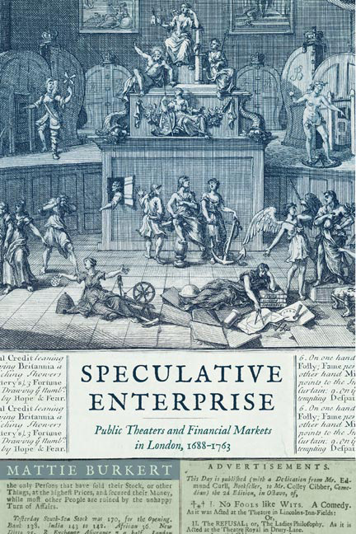
Speculative Enterprise:
Public Theaters and Financial Markets in London, 1688-1763
University of Virginia Press, 2021
Notes:
“Not Acted These Many Years” encapsulates the productive tension between novelty and familiarity that animates British performance culture of this period. It is a tension I explore at length in my 2021 monograph on the relationship between public theaters and the rise of speculative finance in the early eighteenth century. [Gratitude to Professor Emerita Kristina Straub]

Slide 6
“Revivals and adaptations of Tudor and early Stuart plays drew attention to the experience of markets a century earlier, while new plays self-­ consciously reworked inherited tropes and genres to meet the needs of the day. In engaging with dramatic tradition in these ways, the theater complicated both nostalgic visions of England’s precapitalist past and uncritical celebrations of its fiscal modernity.”
Speculative Enterprise, page 3
Notes:
In my book, I explore how British performance culture of the long eighteenth century cultivated forms of historical consciousness that were pivotal to the emergence and consolidation of financial capitalism during this period.
“Revivals and adaptations of Tudor and early Stuart plays drew attention to the experience of markets a century earlier, while new plays self-­ consciously reworked inherited tropes and genres to meet the needs of the day. In engaging with dramatic tradition in these ways, the theater complicated both nostalgic visions of England’s precapitalist past and uncritical celebrations of its fiscal modernity.” (3)
I’ll offer just one example, taken from a 1697 prologue to The Sham Lawyer; or, The Lucky Extravagant, a play attributed to James Drake. Prologues were topical pieces, often delivered at a single performance or small handful of performances; as a result, they tended to engage with current events, often drawing connections to the content of the main entertainment.

Slide 7
For like our Mints, our Scribler has made bold,
To make all new by melting down the Old.
Nor can you blame him, if he has the Skill,
But to maintain the Ancient Standard still;
For, what he finds in weight deficient grown.
He will make good with Bullion of his own.
1697 prologue to The Sham Lawyer
cited in Speculative Enterprise, page 73
Notes:
This particular prologue reflects on how one giant of the pre-Civil War repertory, John Fletcher, was updated and recycled at the end of the seventeenth century. The Sham Lawyer was an adaptation and amalgamation of two Fletcher plays: Wit without Money and The Spanish Curate (the latter co-written with Philip Massinger). In the midst of a currency crisis, this prologue draws parallels between perceived shortages of coin and dramatic wit. It expresses anxiety about economic and cultural compensatory strategies, including the use of spectacle to update Elizabethan and Jacobean drama that was primarily verbal rather than visual.
For like our Mints, our Scribler has made bold,
To make all new by melting down the Old.
Nor can you blame him, if he has the Skill,
But to maintain the Ancient Standard still;
For, what he finds in weight deficient grown.
He will make good with Bullion of his own.
Here, adaptation works in precisely the same way as the ongoing recoinage: the materials of past generations, which have “deficient grown,” undergo a process of “melting down” and being supplemented with new “Bullion” in order to return them to “the Ancient Standard.” These lines make the case that the values of the past can be kept alive only if they are augmented with new materials; they can only remain current if revived. At the same time, the playwright still aspires to the “Ancient Standard.” Like the recoinage, the reshaping of the theater in the 1690s sought to restore drama to an earlier standard while also introducing new features and forms that, like milled edges on coins, made drama “current.” The delivery of this prologue at Drury Lane is significant: the young company there was mounting a full-court press against the rival Actors’ Company at Lincolns Inn Fields, led by Restoration giant Thomas Betterton. In this context, it is particularly interesting to register the prologue’s ambivalent embrace of new generation of playwrights who are reworking their dramatic inheritance in complex ways.

Slide 8
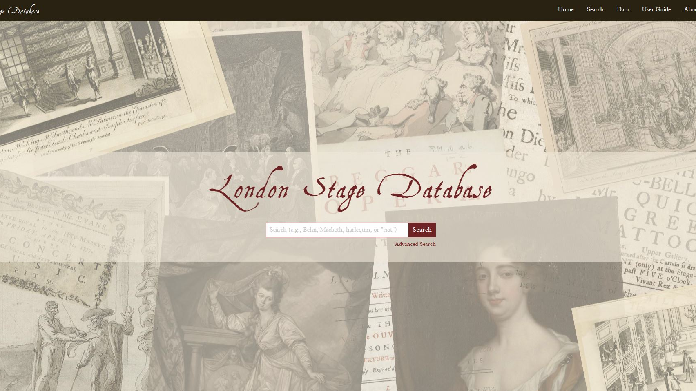
https://londonstage
database.uoregon.edu
Notes:
Similar concerns lie at the heart of my ongoing project, the London Stage Database. The site launched in 2019, more or less in its current form: an open-access database that includes details about more than 52,000 theatrical performances recorded between 1660 and 1800. These records, largely drawn from playbills and newspaper advertisements like those I showed before, were collected and published in calendar form in the 1960s as The London Stage, 1660-1800.

Slide 9
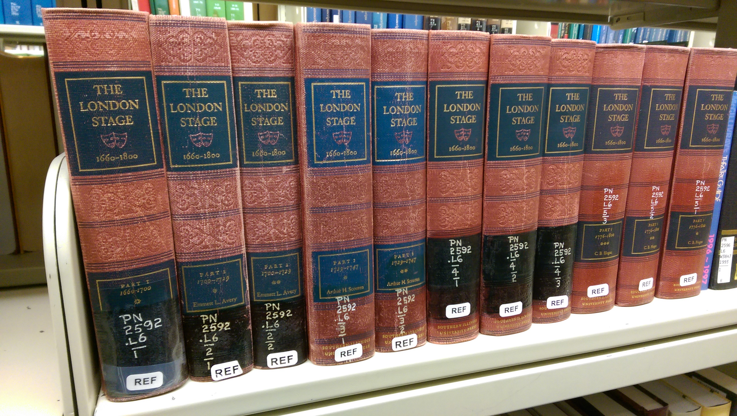
Notes:
The resulting eleven-book, 8,000-page reference series has remained foundational in the field despite having gone through a single print run. When I was a graduate student a decade ago, the only way to consult these books was to gain access to the reference room of an academic library—and a well-resourced one, at that.

Slide 10
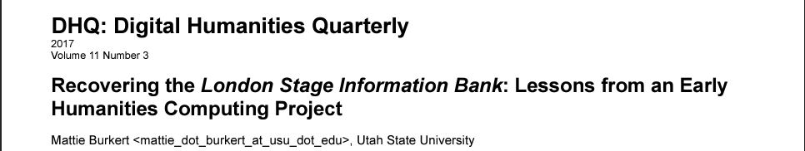
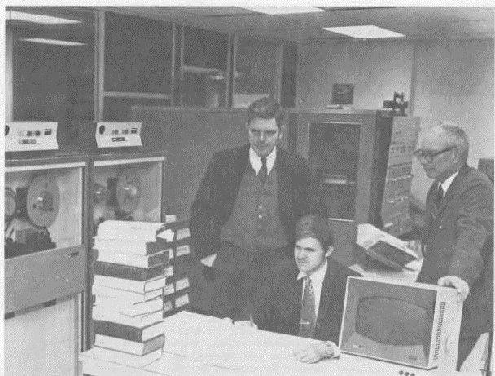
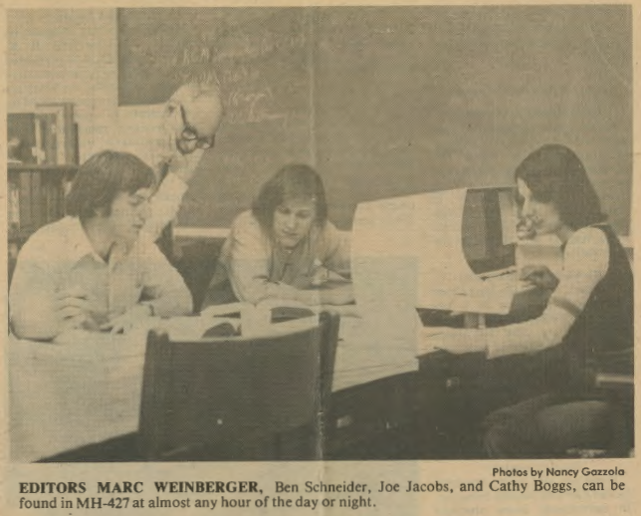
digitalhumanities.org/dhq/vol/11/3/000321
Notes:
That’s not to say that no one tried to make them more accessible. An early humanities computing project, called the London Stage Information Bank, first attempted to render these records computationally addressable in the 1970s, with major funding from the NEH, ACLS, NSF, and the Billy Rose Foundation, among others. That project’s outputs were obsolete almost as soon as they were released, however, and the existence of the Information Bank largely disappeared from disciplinary memory for several decades. For those interested in the data detective story, I wrote about it this piece for Digital Humanities.
“Recovering the London Stage Information Bank: Lessons from an Early Humanities Computing Project,” Digital Humanities Quarterly, Volume 11, Number 3 (2017)

Slide 11
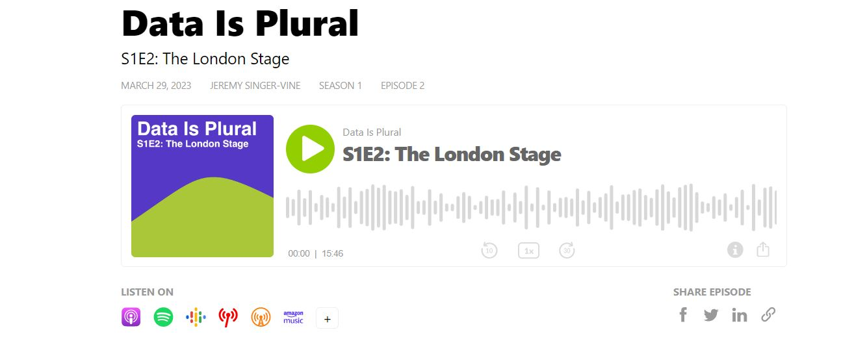
https://podcast.data-is-plural.com/2159594/12535551
Notes:
I also recorded an interview about it with Jeremy Singer-Vine (now, data editor at the New York Times) for his podcast, Data is Plural.
Recovering this obsolete project was the goal at the heart of the first phase of the London Stage Database project, which was funded by the NEH Office of Digital Humanities from 2018 to 2019 through their Advancement Grant program. For those familiar with the DHAG funding stream and its priorities, it might seem curious that a database of theater historical records is being funded by the ODH rather than through one of the Endowment’s programs for supporting collections and reference resources. The reason for that has to do with this project’s archaeological approach, understood in at least two ways:

Slide 12
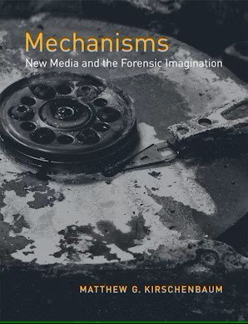
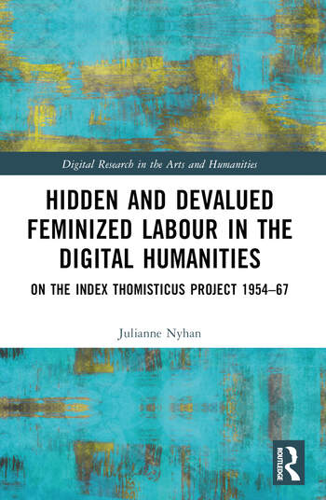
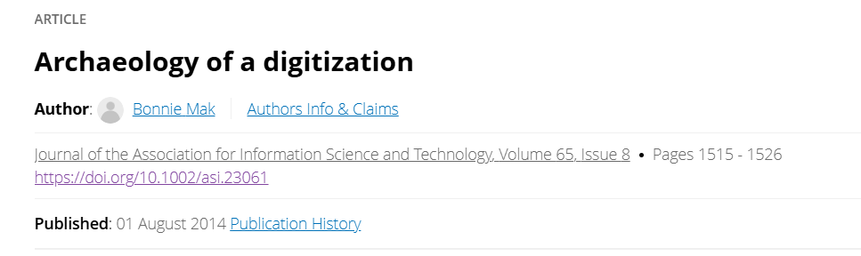
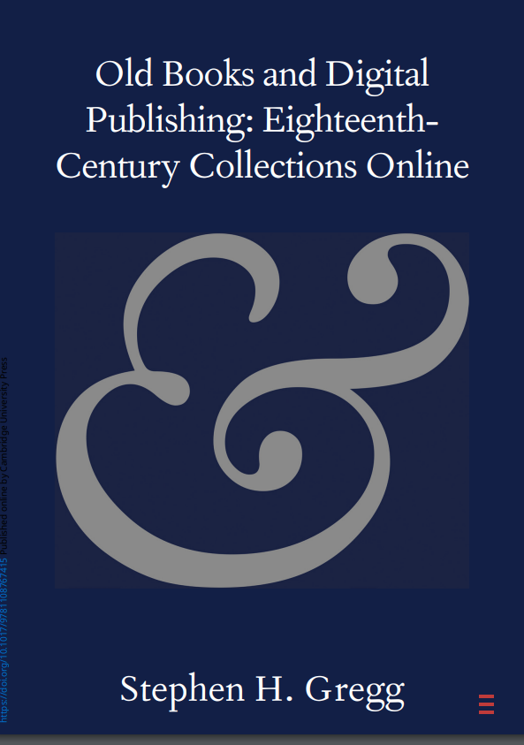
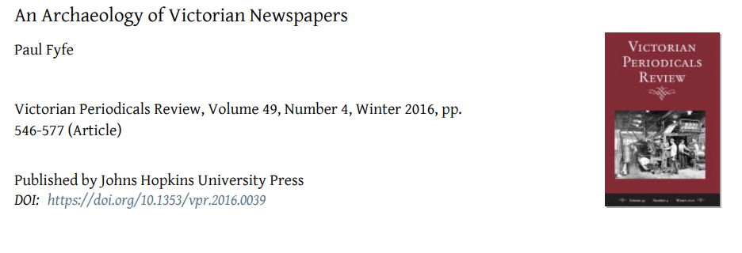
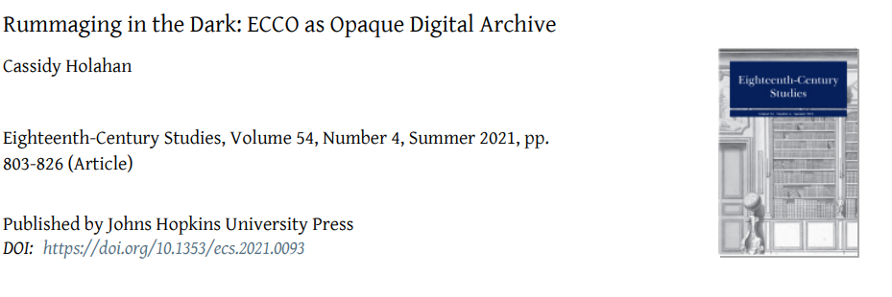
Notes:
1. media archeology, which includes the forensic recovery of past media forms and their means of access, a la Matthew Kirschenbaum
2. following work by folks like Julianne Nyhan, Stephen Gregg, Cassidy Holohan, and especially Bonnie Mak and Paul Fyfe, I see the London Stage Database as part of a wave of work that aims to uncover the lost or obscured media histories of our research materials. As many others have noted, these large-scale digitization projects and databases increasingly define the conditions of possibility for our inquiry, constituting an under-recognized research infrastructure for the humanities -- even for those who don’t identify as digital humanitists.

Slide 13
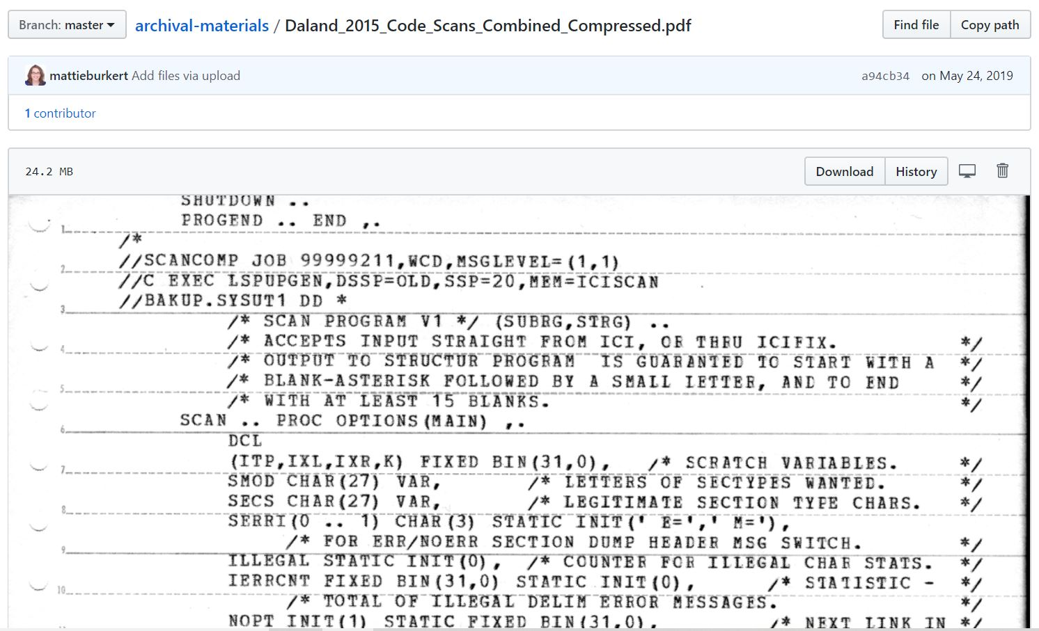
Notes:
So, in 2018, and armed with some bit-rotten floppy disks and reams of dot-matrix printouts, our small team succeeded in revitalizing the remains of the Information Bank, manually re-encoding thousands of lost entries according to the original project’s makeshift schema, and converting the resulting flat-file database to a modern relational structure. So perhaps, from the perspective of the funders, there was another sense of recovery at play – the recovery of sunk costs.

Slide 14
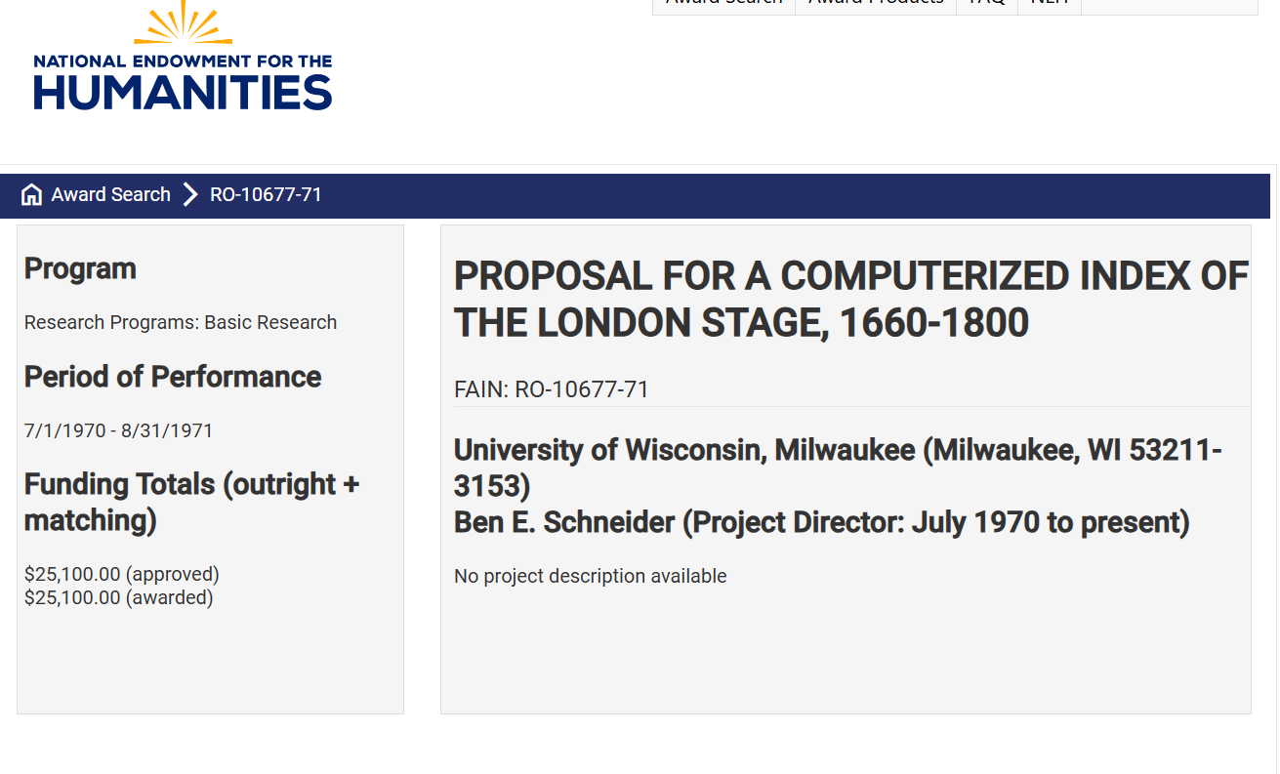
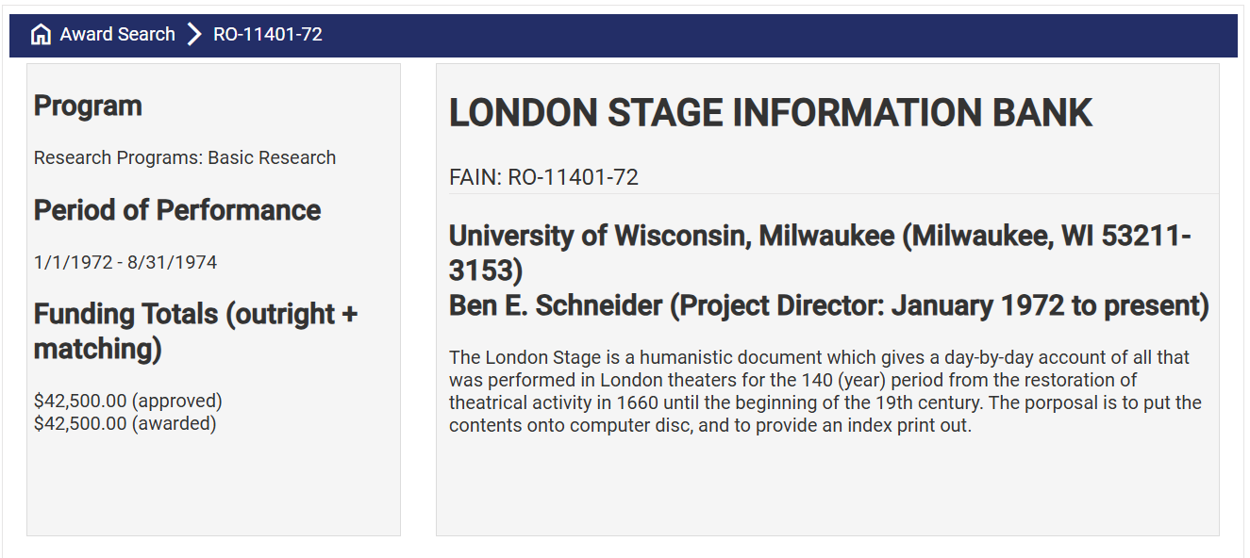
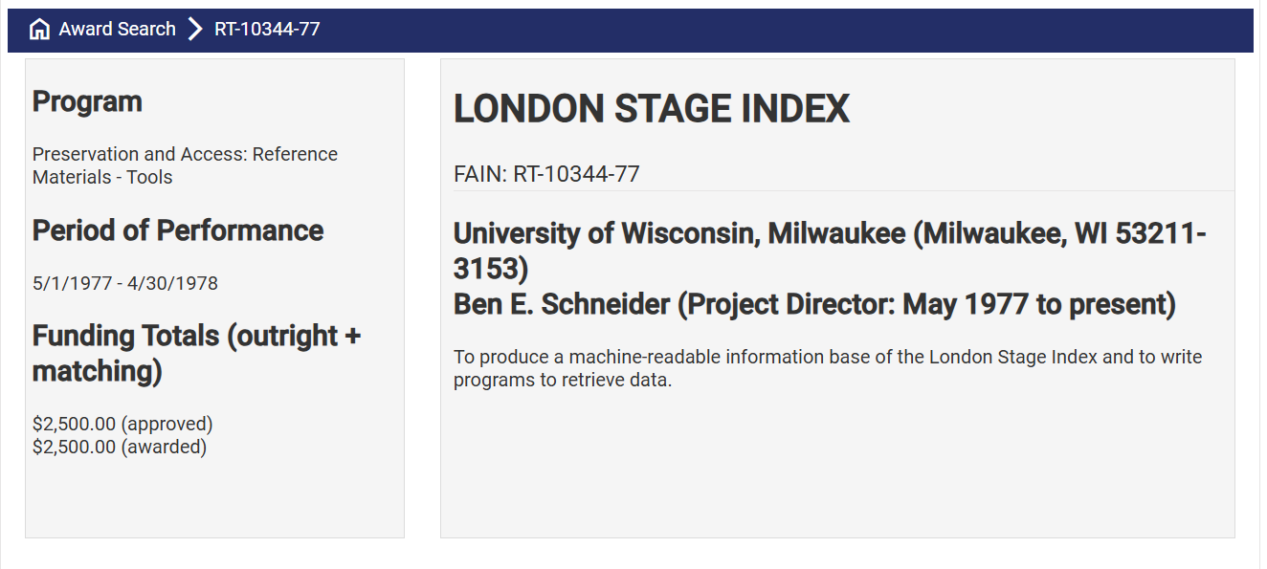
Notes:
With the NEH’s public query system, it’s possible to get a sense of just how much money a single funder poured into the various resources that eventually constituted the London Stage Information Bank.
$21,500 in 1970 = $203,970 in 2024
$42,500 in 1972 = $320,581 in 2024
$2,500 in 1977 = $13,007 in 2024
So, that’s more than $537,000 in today’s money spent just on the Information Bank and associated print Index, and just by the NEH (not counting the funding from NSF, ACLS, Billy Rose Foundation, and so on). The $75,000 grant they awarded to my team at Utah State starts to look like a bargain. And I didn’t actually realize until running this search just how far I came in under budget!

Slide 15
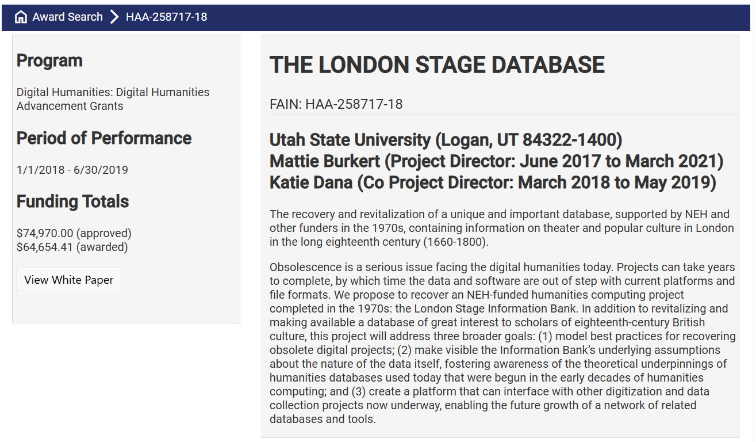
Notes:
The $75,000 grant they awarded to my team at Utah State starts to look like a bargain. And I didn’t actually realize until running this search just how far I came in under budget!
https://apps.neh.gov/publicquery/AwardDetail.aspx?gn=HAA-258717-18

Slide 16
Funding
Acknowledgment
The London Stage Database is made possible in part by grants from the National Endowment for the Humanities. Any views, findings, conclusions, or recommendations expressed here do not necessarily represent those of the NEH.
Additional support is provided by the Office of the Vice Provost for Research and Innovation, the College of Arts and Sciences, and the Department of English at the University of Oregon, as well as UO Libraries and UO Information Services. Past funders include the College of Humanities and Social Sciences, the Department of English, and the Office of Research at Utah State University.
Notes:
Recently, our team was awarded a larger Level III grant to support three years of active development work. Here I’m obliged to mention that any views, findings, conclusions, or recommendations expressed in my talk today do not necessarily represent those of the NEH.

Slide 17
The Team
PI: Mattie Burkert
Informationists: Franny Gaede, Kate Thornhill, Erin Winter
Linked Open Data Consultant: Lauren Liebe
Research Assistants: Michele Pflug, Emma Kaisner
Developers: John Zhao, Dennis Pipes
Advisory Board: Misty Anderson, Michael Gamer, Michelle J. Holman, Todd Hugie, Atesede Makonnen, Derek Miller, Chelsea Phillips, Jeffrey S. Ravel, Fiona Ritchie, Jeremy Singer-Vine, Mark Vareschi, Jane Wessel, Kalle Westerling
Administrative Support: Tyfanie Wineriter, Holly Lakey, Melissa Bowers, Christina Lujin, David Yorgeson, Kathy Furrer
More at londonstagedatabase.uoregon.edu/about.php
Notes:
I’m also ridiculously lucky to be working with an absolute dream team of informationists, researchers, developers, and administrative staff from the College of Arts and Sciences, the UO Libraries, and Central Information Services at UO. Not to mention a killer advisory board of theater researchers and practitioners (including CMU’s own Professor Makonnen), data scientists and storytellers, librarians, technologists, professional genealogists, and digital humanists. With the next three years of funding, our team is extending the dataset with additional primary and reference sources; enhancing interoperability with other projects using Linked Open Data; and upgrading the technical infrastructure to (hopefully) avoid the fate of our predecessor.

Slide 18
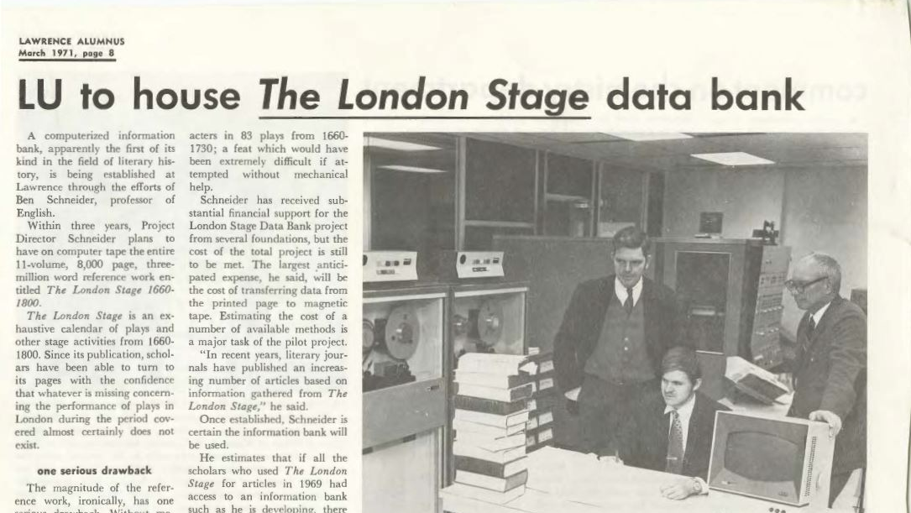
Notes:
Image from Lawrence University Archives

Slide 19
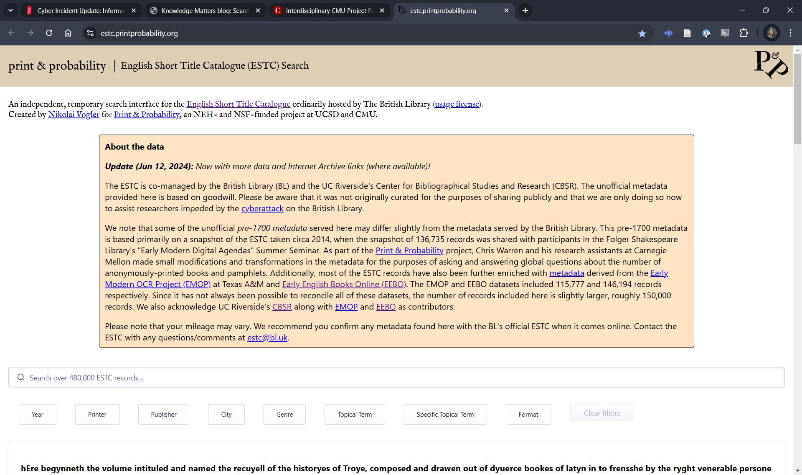
Notes:
For example, the English Short Title Catalog has been down for over a year, following the massive cyberattack on the British Library. If you would have asked me to bet on resources that would be around throughout my career, I would have put money on estc.bl.uk, simply because of the simplicity of the technical implementation, the widespread use and citation of the resource, and the (perceived) longevity and stability of the host institution. Thankfully, the Print and Probability project here at CMU has saved our bacon by mirroring a snapshot of the database from a year ago.

Slide 20
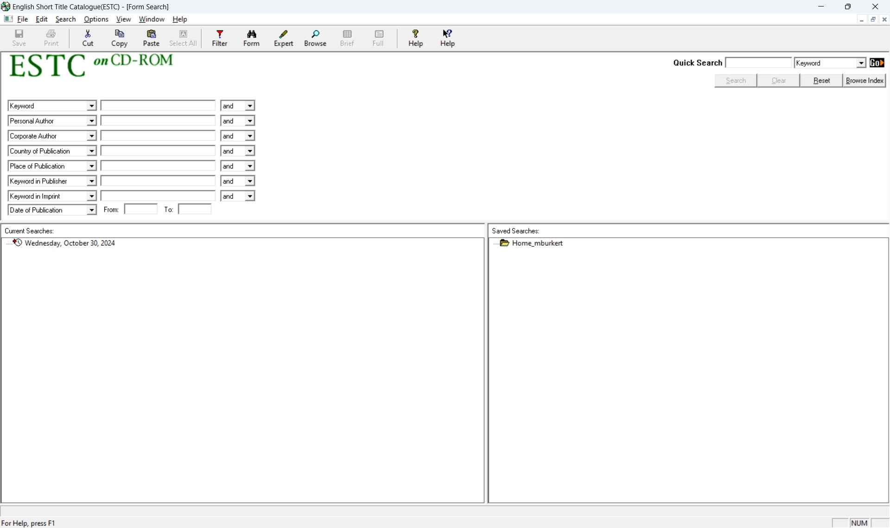
Notes:
To supplement it, my team has also installed the ESTC on CD-ROM from 2003. Still works great, surprisingly enough. Still, I do find myself wishing UO had hung onto all the printed short title catalogs I used to refer to back in grad school.

Slide 21
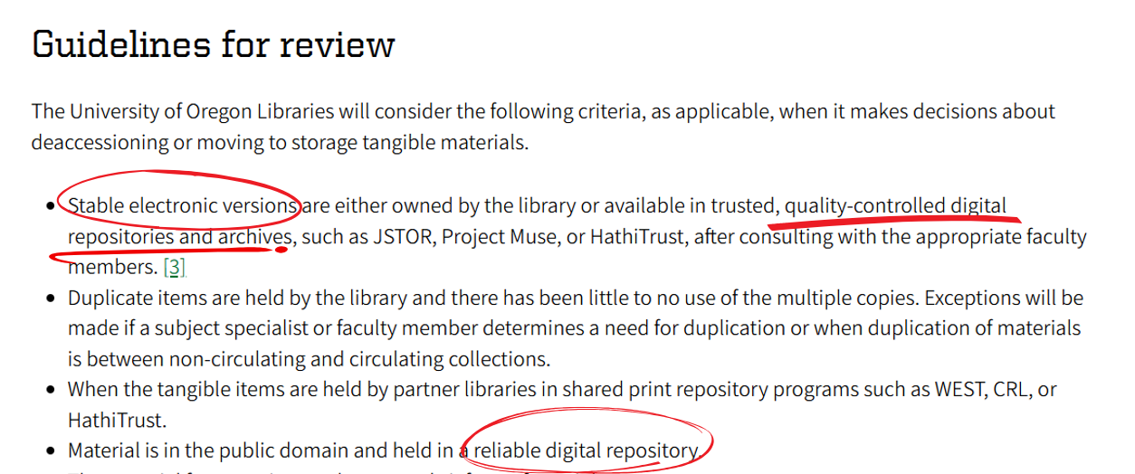
Notes:
Unfortunately, like many institutions, mine seems to have decided (largely without consulting domain OR key library faculty) that print reference collections are no longer needed, since digitized resources are forever.

Slide 22
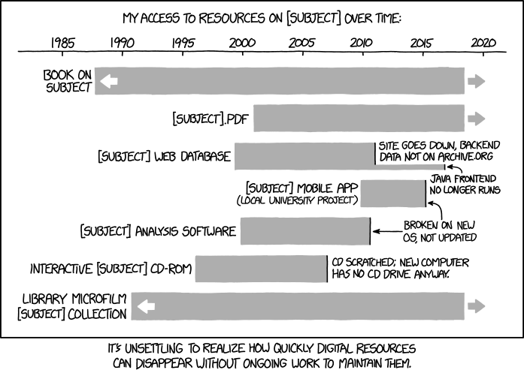
Notes:
https://xkcd.com/1909
My access to resources on [SUBJECT] over time:
[Below, a timeline and a graph with gray bars is shown:]
[1980s-past 2020:] Book on subject
[Early 2000s-past 2020:] [SUBJECT].pdf
[2000-2010:][SUBJECT] web database
[Small bar, 2000-2016/17:] Site goes down, backend data not on archive.org, Java frontend no longer runs
[2010-2015/16:][SUBJECT] mobile app (Local university project)
Broken on new OS, not updated
[2000-2010:][SUBJECT] analysis software
Broken on new OS, not updated
[Late 1990s-late 2000s:]Interactive [SUBJECT] CD-ROM
CD scratched; new computer has no CD drive anyway.
[1980s-past 2020:]Library microfilm [SUBJECT] collection
[Caption below the panel:]
It's unsettling to realize how quickly digital resources can disappear without ongoing work to maintain them.
Hover-over text: I spent a long time thinking about how to design a system for long-term organization and storage of subject-specific informational resources without needing ongoing work from the experts who created them, only to realized I'd just reinvented libraries.

Slide 23
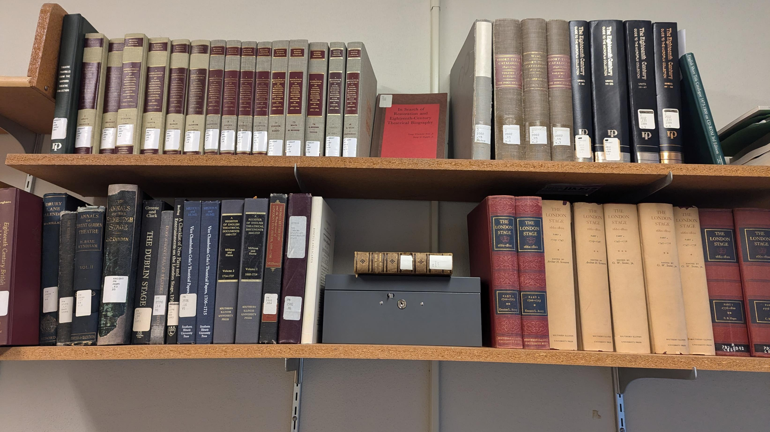
Notes:
This is our nascent reference library in the office used by the London Stage Database team – mostly made up of volumes the Libraries had moved from reference to stacks in preparation for retirement, along with a full set of The London Stage, 1660-1800 frankensteined together from half a dozen rare booksellers.
We know that websites are hacked, project leaders change jobs, teams lose funding because asking for money to sustain and preserve existing work is a much harder sell than promising to do something new. Returning to the theater analogy: maintaining any space of collective cultural production—whether that be a physical playhouse, a theatrical repertory, or a digital humanities project—requires constant, often invisible work by a network of individuals who care enough about the underlying material to continually transform it as times and technologies change. And they do change.

Slide 24
“Our system cannot become obsolete from advances in hardware, because our programs are written in BASIC and PL/1, assiduously supported by Digital Equipment Corporation and IBM, the two leading computer manufacturers: there is no chance that either will build computers that are incompatible with these programming languages, or that Lawrence would be so foolhardy as to buy computers incompatible with ten years programming work.”
Letter from Ben R. Schneider, Jr. to Leeds Barrol,
15 January 1976, Lawrence University Archives
Notes:
Websites are hacked, project leaders change jobs, teams lose funding because asking for money to sustain and preserve existing work is a much harder sell than promising to do something new. The disappearance of the London Stage Information Bank in the 1980s vividly illustrates the particular risks of untimely loss that arise when the material conditions of technology development meet those of humanities scholarship. As project director Ben R. Schneider, Jr. put it in a 1976 letter to a skeptical patron: “Our system cannot become obsolete from advances in hardware, because our programs are written in BASIC and PL/1, assiduously supported by Digital Equipment Corporation and IBM, the two leading computer manufacturers: there is no chance that either will build computers that are incompatible with these programming languages, or that Lawrence would be so foolhardy as to buy computers incompatible with ten years programming work.”
Now, I’ve been showing people this quotation for a decade and telling anyone who will listen that we need to learn from the past. And wouldn’t you know that the following line appears in my data management plan for the latest London Stage Database grant:

Slide 25
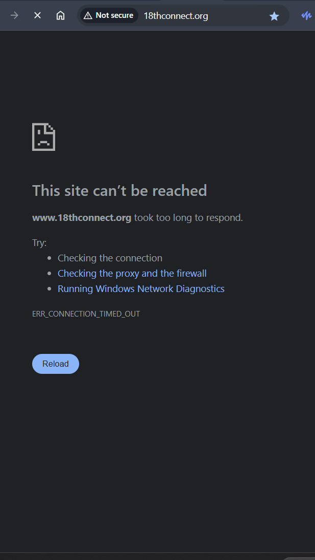
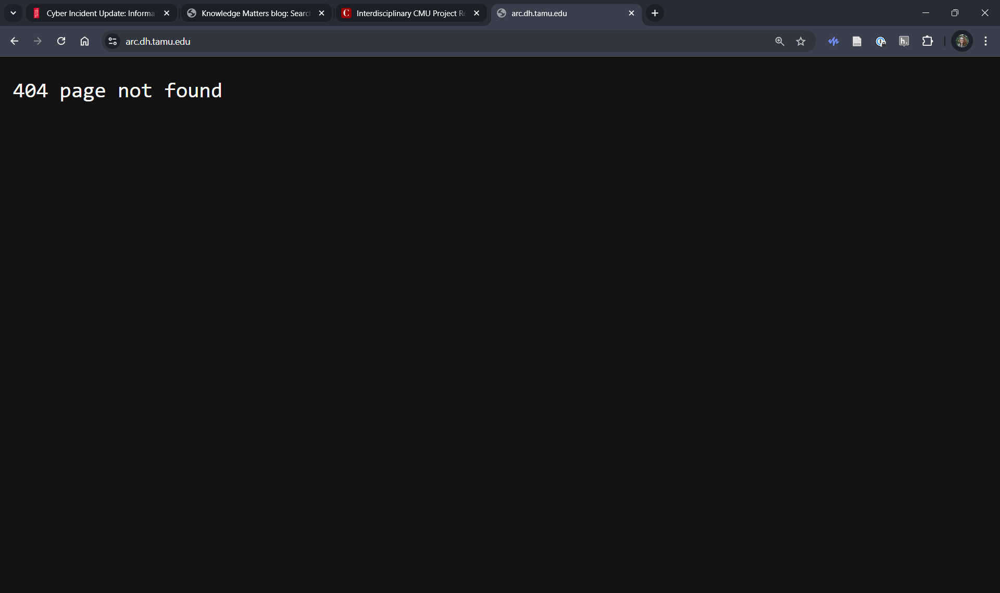
LSDB Data Management Plan, 2023: “The project team will continue to promote data access, reuse, and distribution by…submitting the final project data and metadata for re-review and re-federation into the Advanced Research Consortium’s 18thConnect and NINES discovery platforms.”
Notes:
“The project team will continue to promote data access, reuse, and distribution by…submitting the final project data and metadata for re-review and re-federation into the Advanced Research Consortium’s 18thConnect and NINES discovery platforms.”
Images: 18thConnect.org now throws an error that the site can’t be reached; 404 error showing that the entire ARC domain is down.

Slide 26
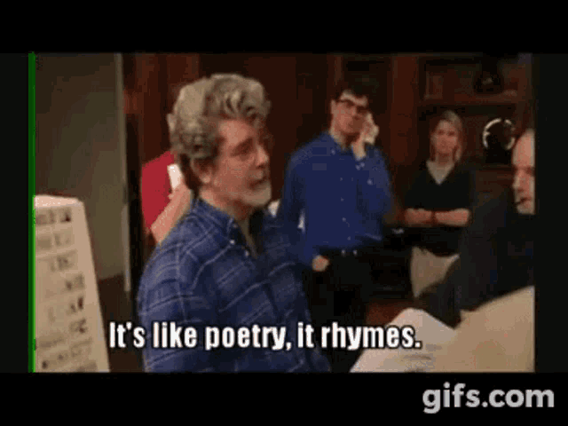

Slide 27
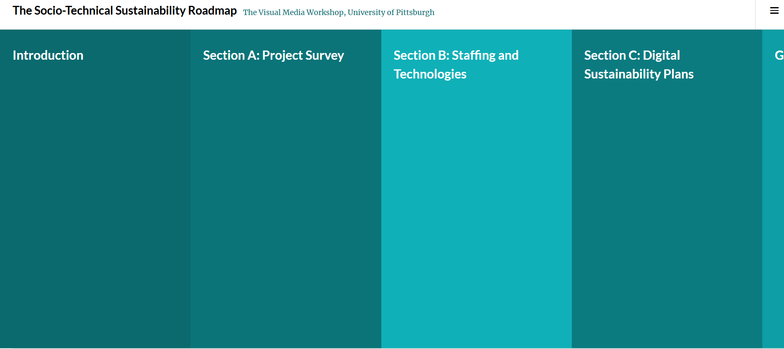
Notes:
Sociotechnical Sustainability Roadmap, Pitt Visual Media Workshop: sustainingdh.net
Of course, we do our best. I and another member of the team, Todd Hugie, had the opportunity to participate in one of the “Sustaining Digital Humanities” Institutes run by folks from the Sociotechnical Sustainability Roadmap project at Pitt. We adopt many of the best practices that we know help to promote discovery, access, and reuse: FAIR data principles (go-fair.org); portable, non-proprietary file formats; open-source programming languages and development stacks; robust version control and documentation; etc. We have little doubt that our open research practices will help to ensure the continued existence of our dataset and code, and their availability to researchers in some form for decades to come.
We’ve also learned a lot from STSR and from the work of folks like Jess Otis at GMU about the importance of distinguishing between sustainability and preservation. It requires much more ongoing effort to ensure the continued availability of a stable, secure, fully functional version of the project on the open web that can be experienced as it was designed.

Slide 28
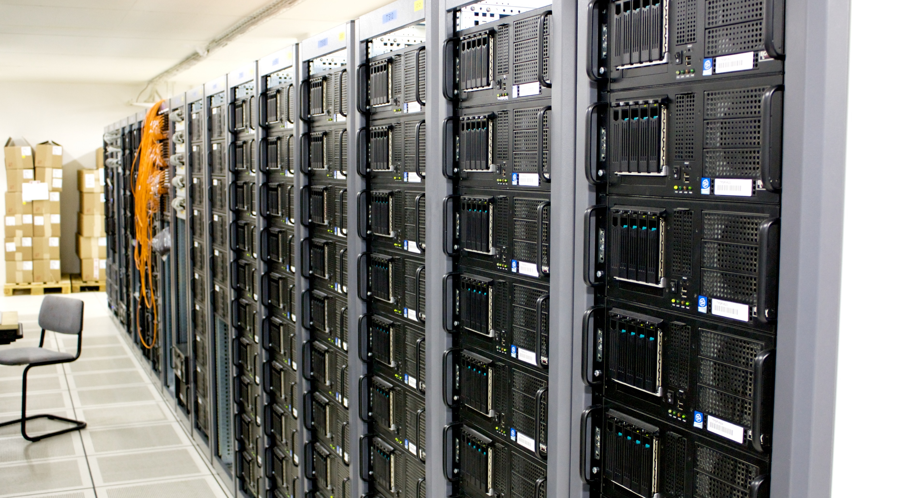
Notes:
"Server room" by torkildr is licensed under CC BY-SA 2.0.
The idiosyncrasies of institutional web hosting arrangements—not to mention, their vulnerability to the larger forces of economic and organizational precarity across the U.S. higher education sector—render web hosting and server-side maintenance the single most important sociotechnical vulnerability facing the field of DH today.
In the absence of a federal research computing infrastructure open to digital humanities practitioners, the care and feeding of web-based DH projects requires strong and ongoing commitments from academic and cultural heritage institutions. Yet securing these commitments is entirely contingent on local contexts that can be intricate and remain largely invisible to most researchers. Addressing the challenges of virtual machine access, domain registration, and server-side maintenance has required radically different approaches within the distinct socio-technical landscapes of my two institutions. Securing an extended web hosting agreement at Utah State University during the project’s NEH-funded development phase in 2018-19 was challenging because of that university’s radically decentralized computing infrastructure, a relic of security measures taken to protect the former NASA research hub from remote hacking and surveillance. As a result, it was easy for our team to get direct access to a university-owned virtual machine, but almost prohibitively difficult to hook that server up with other computing resources or even assign the site to the usu.edu domain.
Web hosting is likewise a pain point at UO, but for different reasons: the centralization of Information Services has created a one-stop shop for integration of university-licensed enterprise solutions like Microsoft Azure on uoregon.edu sites, but it has also limited faculty members’ direct access to host custom research-driven websites on UO servers. UO’s research computing infrastructures, like those of many major research universities, respond primarily to STEM funding imperatives; increasingly, the research computing infrastructure on our campus is also being shaped by the needs of the explosively growing Data Science Initiative Institutional incentives push researchers to centrally supported software and hosting solutions that reflect enterprise software logics and economies of scale, rather than the needs and values of humanities scholarship. The push to enterprise solutions represents the technocapitalist imperative to outsource and automate, which we in the humanities should resist but too often capitulate to, imagining ourselves outside of or above these structures in which we are complicit (see Mak, “The Sweatshops of the Digital Humanities;” Risam, “The Revolution Will Not Be Turk-ified”; Burkert, “From Manual to Digital,” etc.). LSDB continues to advocate for technical infrastructures that is nimble enough to handle individualized projects built using alternative systems and platforms that model potential avenues for broader sociotechnical change.

Slide 29
Notes:
The central insight of STSR is that technology is irreducibly social: we cannot address technical challenges independent of their social embeddedness. For our team, putting this insight into action means thinking about sustainability not only in terms of file formats, software stacks, and storage media, but also in terms of disciplinary norms, professional incentives, and institutional histories and structures. The tech sector is accustomed to thinking about software “dependencies” as vulnerabilities, for obvious reasons: half of the internet seems to go down for a few days following a major PHP upgrade. Yet interdependence can also be a strength. LSDB is embedded in a web of technical systems that have to all work together, yes; but those systems are supported by the open source software community, rather than dependent on the priorities of a single company. We are also embedded in a web of relationships with to allied projects like Romantic Melodrama, the R/18 Collective, Theatronomics, the Comédie Française Registers Project. Our planned efforts to incorporate more Linked Open Data and to strengthen our ties with the genealogy research community are intentional efforts, not to mitigate, but to deepen our interdependence with others’ work. By making our work as freely available as possible for others to use and build on, we aim to embed LSDB in the fabric of our disciplines and communities of practice, expanding the network of individuals and institutions who have a stake in sustaining this project.

Slide 30
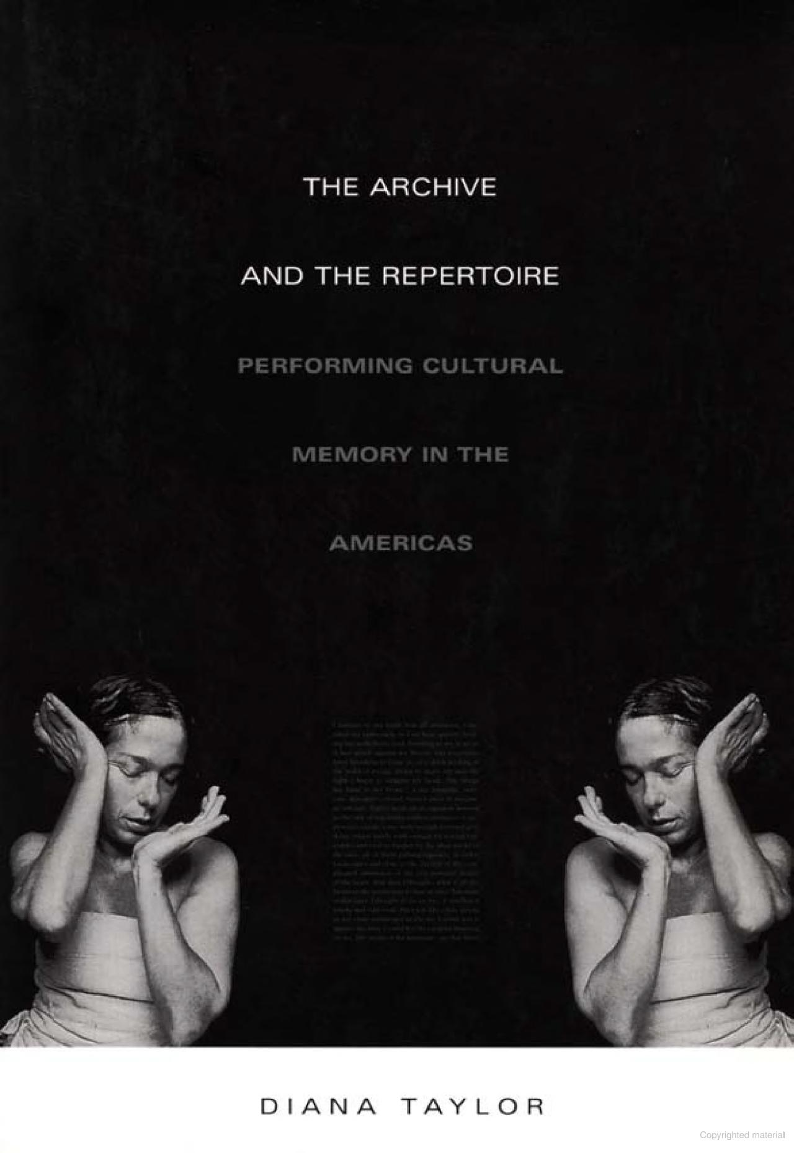
Notes:
We might think about these twin goals of sustainability and preservation in terms of Diana Taylor’s influential formulation in The Archive and the Repertoire. The preservation of digital project outputs is not unlike the archive of performance, inscriptions that enlist technologies of memory to bear witness to past configurations of the actor-network and the ways of knowing that emerge from it. Equally important, though, is the repertoire: the embodied and experiential memory embedded in the human infrastructure. There are actors alive today who are the keepers of hundreds of years of performance tradition that simply can’t be inscribed in any medium other than the human body. [Example of R/18 EOTM] So we need to think about human infrastructure in terms of curriculum and training pipelines. Reports of the death of the English major have been greatly exaggerated, of course. But there is still de-skilling taking place even in programs with healthy enrollments. In many cases, we are losing audience for or avenues to teach skills like bibliographic notation, paleography, and collation. These aren’t arcane skills. They’re our repertoire: the embodied ways of knowing that maintain our means of accessing, reading and writing to, the archive. Without them we’re like actors reading the promptbook for an 18th-century pantomime without any way of reproducing the necessary gestures.

Slide 31
Notes:
I also recognize another opportunity to pass along an experiential understanding of the layers of theater and media history underpinning the database: the website interface itself. I want to show you some examples, but first, let me back up a bit. In that DHQ essay, I argued that one of the reasons the Information Bank never found its audience was because it expressed the epistemological assumptions and scholarly desires that animated midcentury theater history, the positivist bent of which was out of step with the poststructuralist turn of the 1980s. Joe Drury argues that “the history of literary studies is…a series of interdisciplinary experiments in the ontology of the literary object.” Your standard critical theory survey (is there such a thing anymore?) charts a series of attempts to render the text addressable as a historical document, a semiotic system, an ideological tool, a site for the exploration of repressed trauma, etc. Computational humanities, cultural analytics, or whatever you want to call it, is at least in part an interdisciplinary experiment in the treatment of the literary artifact as data. This has opened it up to accusations of positivism (some, but not all, of which are fair). I do think there is a real risk that a project like mine could reinscribe the ontological foundations of old-school theater history in the register of 21st-century data science.

Slide 32
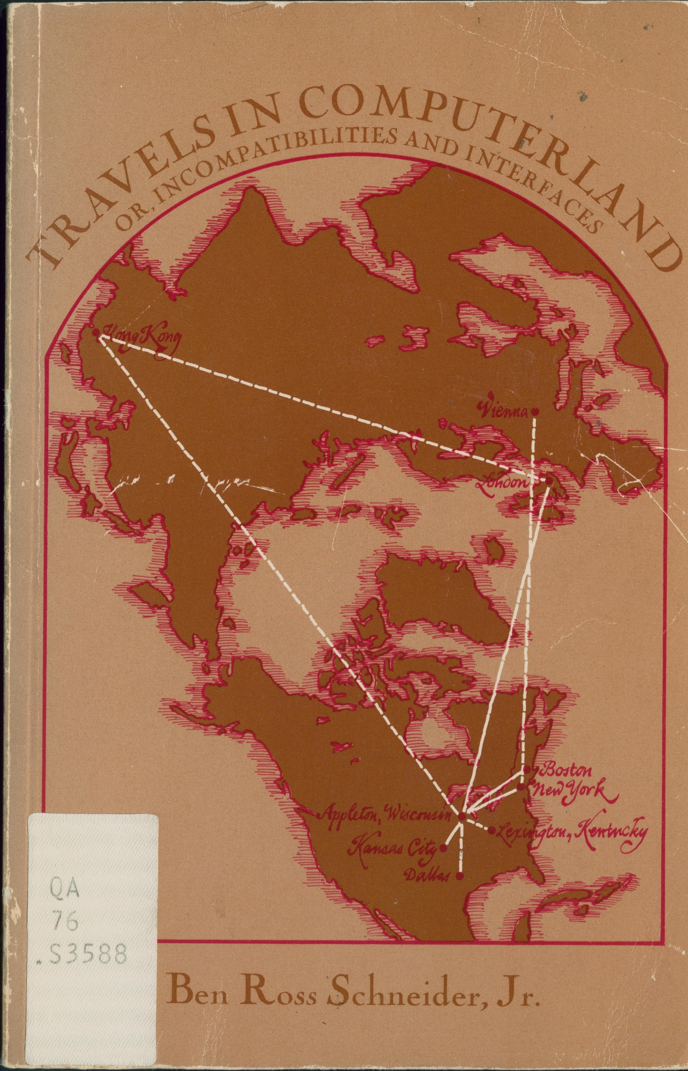
“We can study trends (the rise of pantomime; the interest in Shakespeare; the rise and fall of theatres; the decline of the drama); we can look for patterns (In what ways is one season like another? What is a typical stage career like? To what extent do actors specialize? What is the effect of the repertory system?). There’s too much information about 18th century theatre; without computer help we can’t see the forest for the trees.”
Ben Ross Schneider, Jr., Travels in Computerland (1974), 230
Notes:
Indeed, there’s a slightly uncomfortable echo between the research questions LSIB project director Ben R. Schneider Jr. articulated at the outset of his project and those that data visualizers and storytellers have used the LSDB to investigate: “We can study trends (the rise of pantomime; the interest in Shakespeare; the rise and fall of theatres; the decline of the drama); we can look for patterns (In what ways is one season like another? What is a typical stage career like? To what extent do actors specialize? What is the effect of the repertory system?). There’s too much information about 18th century theatre; without computer help we can’t see the forest for the trees.” (Schneider, Travels in Computerland, 230)

Slide 33
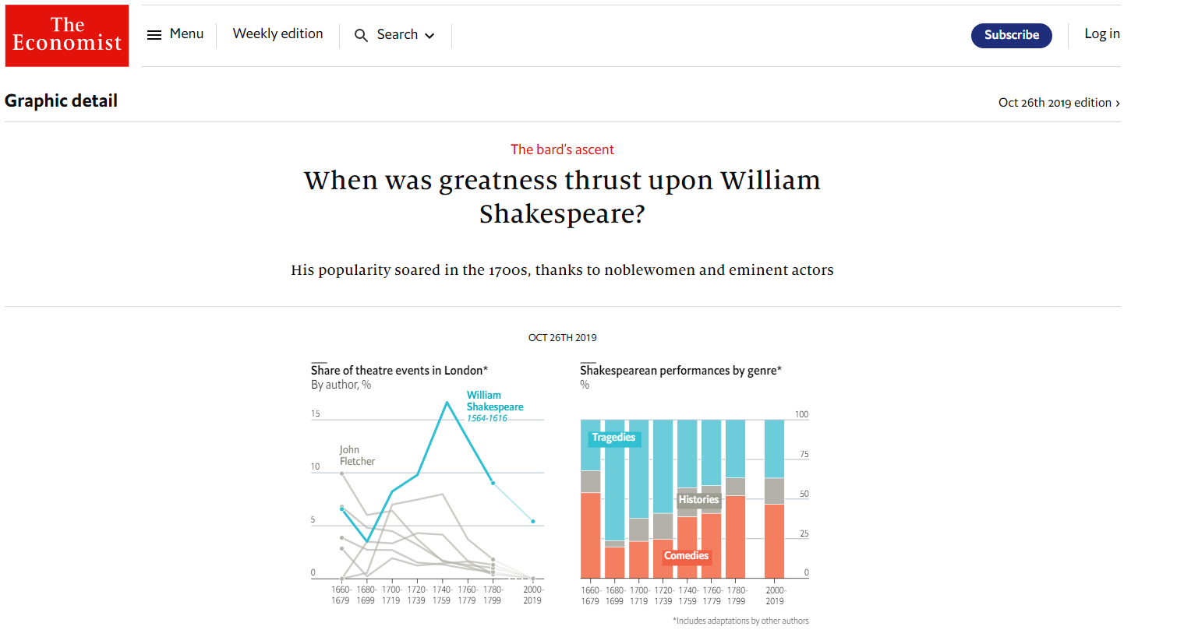
https://www.economist.com/graphic-detail/2019/10/26/
when-was-greatness-thrust-upon-william-shakespeare
Notes:
“the interest in Shakespeare”

Slide 34
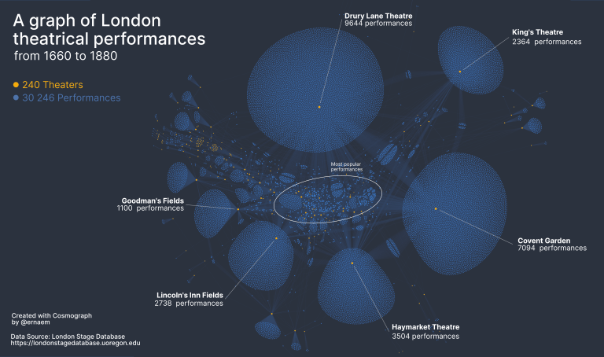
nightingaledvs.
com/data-is-plural-
submissions-london-stage-database
Notes:
“the rise and fall of theatres”

Slide 35
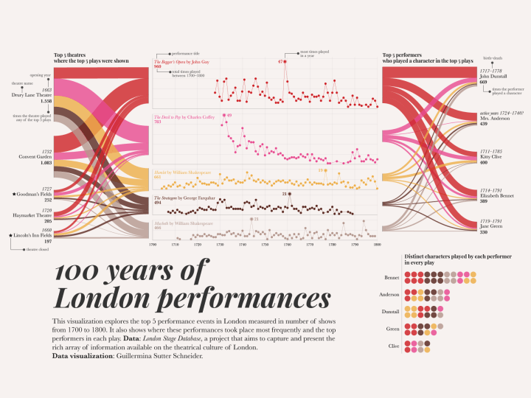
nightingaledvs.
com/data-is-plural-
submissions-london-stage-database
Notes:
“to what extent do actors specialize?”

Slide 36
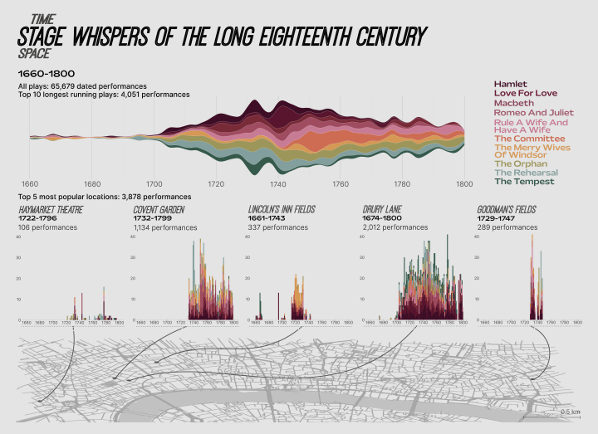
nightingaledvs.
com/data-is-plural-submissions-london-stage-database
Notes:
“what is the effect of the repertory system?
To be clear, I am obsessed with these data visualizations. I think they’re incredibly creative and generative. They just bring me face-to-face with the kinds of inquiry that are suggested by the database in its current form, the historiographies and epistemologies it implies simply by the way it structures and presents the data.

Slide 37
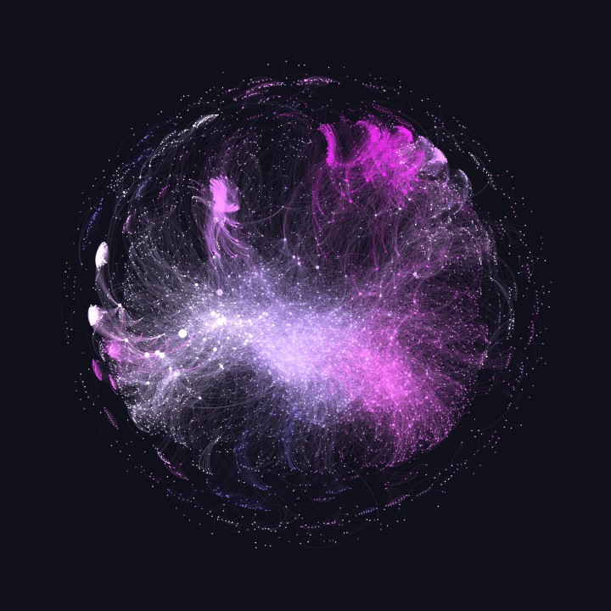
nightingaledvs.
com/data-is-plural-
submissions-london-stage-database
Notes:
But these aren’t the only ends to which the database has been put.

Slide 38
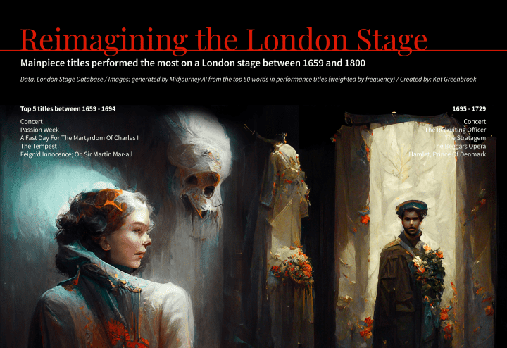
nightingaledvs.
com/data-is-plural-
submissions-london-stage-database
Notes:
I think about these last two as data “visceralizations” more than visualizations, part of the range of experiments we’re seeing with representations of data that engage with our embodied ways of knowing and understanding, rather than purely cognitive appeals. And I think this, too, may be something the project in its current form invites, and that I’d like to do more to encourage.

Slide 39
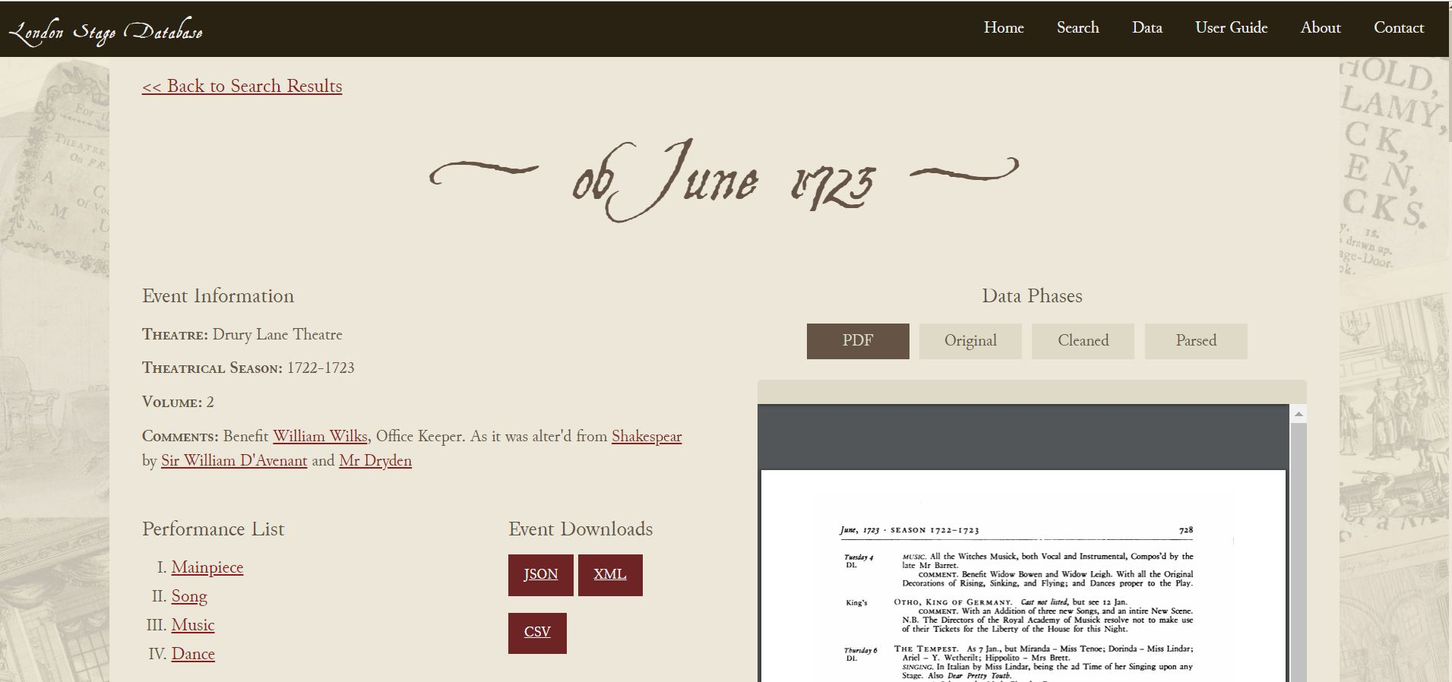
Notes:
One of the main ways the project attempts to resist the pull of reproducing the underlying positivist orientation of the recovered dataset is by focusing on the materiality and historical embeddedness of the dataset.

Slide 40
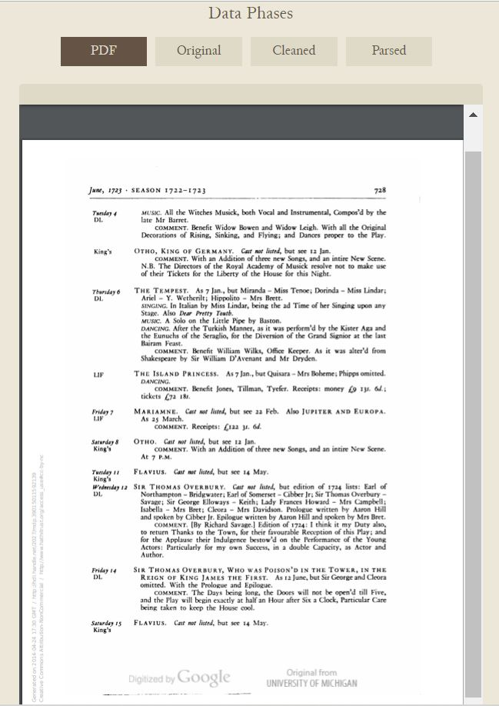
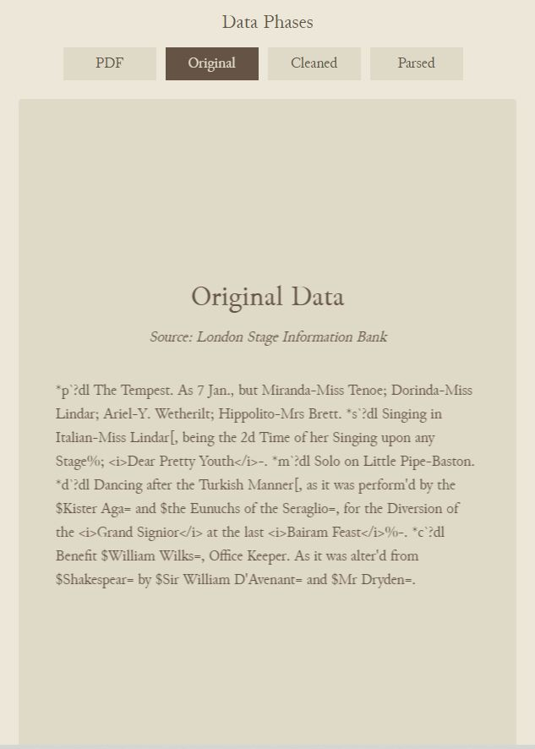
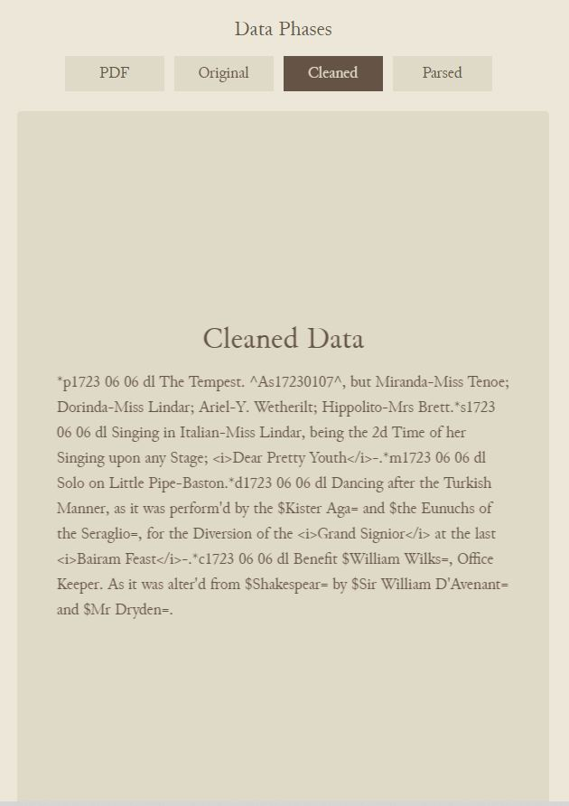
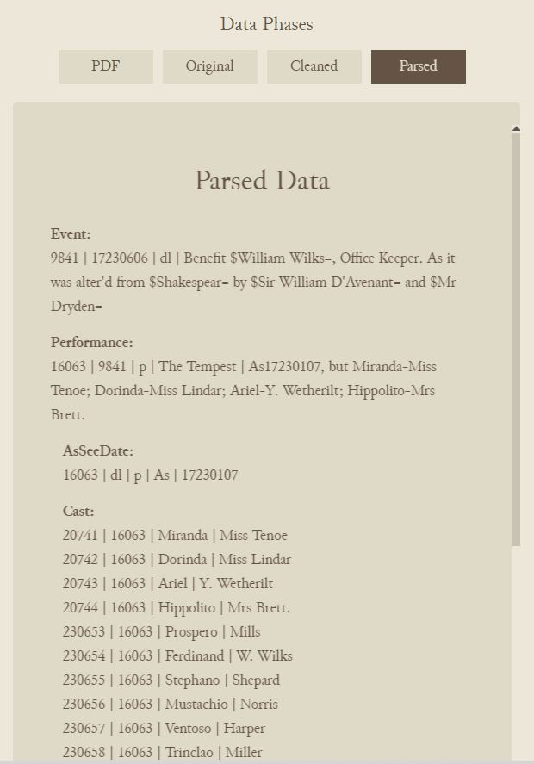
Notes:
Data phases from LSDB

Slide 41
Notes:
Closeup: Original data

Slide 42
Notes:
Closeup: parsed data

Slide 43
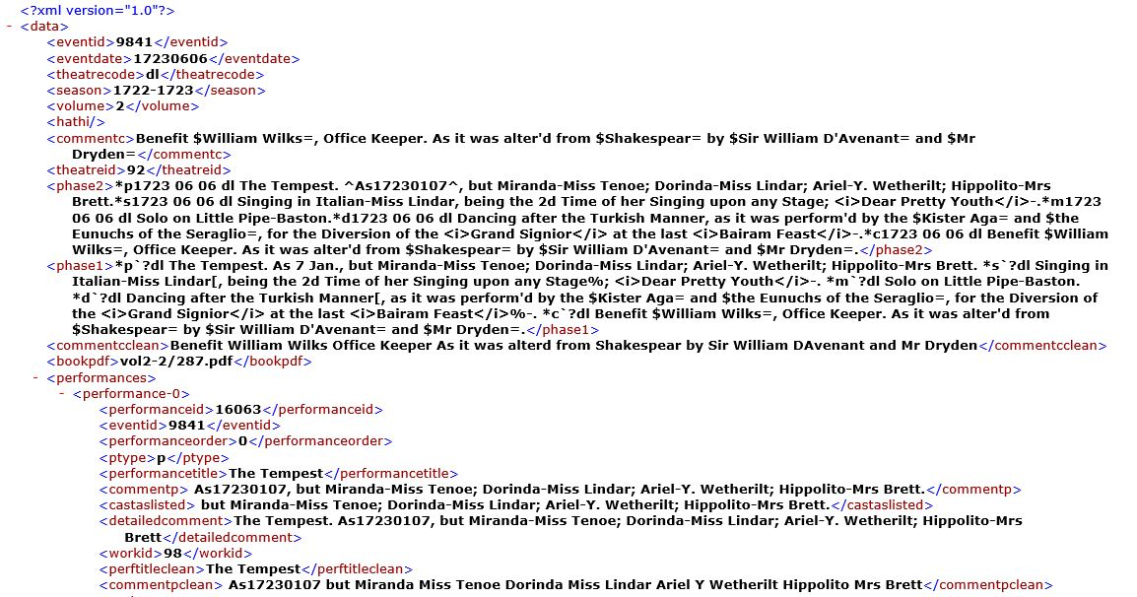
Notes:
XML export of individual event record

Slide 44
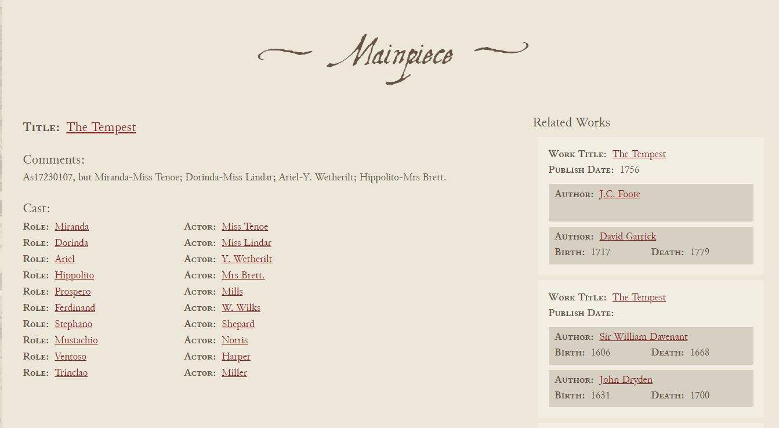
Notes:
Related Works sidebar

Slide 45
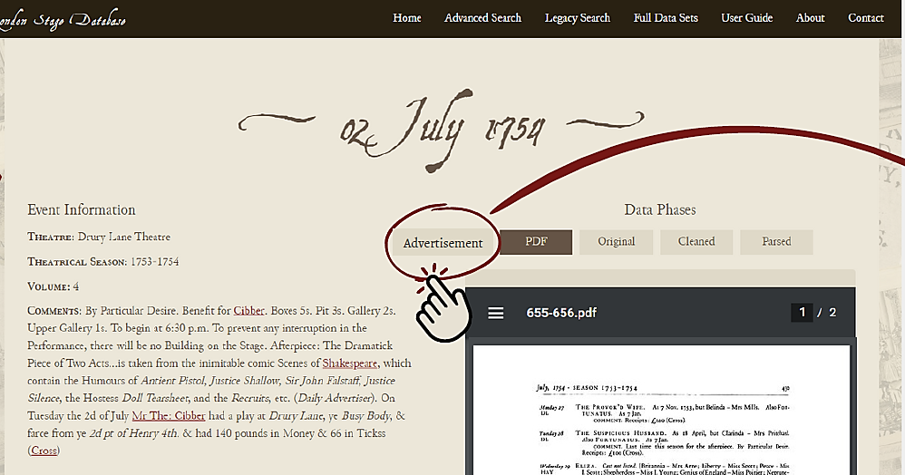


Notes:
Advertisement and transcript

Slide 46




Notes:
Name disambiguation, linked data, and biographical snippets

Slide 47

Notes:
send event to collection

Slide 48

Notes:
These are just a few features we’re looking at implementing. We’re also working on incorporating more of the editorial commentary from the original reference volumes, including contextual information about specific playhouses and seasons; reusing plain-text data from the Text Creation Partnership and Visualizing English Print to enable text-mining applications; and more. Watch this space.

Slide 49
Notes:
To conclude: While making the site more user-friendly, I hope not to lose some of the current – deliberate – frictions built into the existing user interface. Through its procedural rhetoric, the site tries to foreground the ambiguities and uncertainties embedded in a particular dataset. It did not fall out of a coconut tree; it is the product of all that has come before. I hope interacting with the site can help attune readers to the layers of translation and remediation through which any history becomes addressable as data, as well as the ease with which information is lost in that process. Let’s return to the prologue to The Sham Lawyer with which I started:

Slide 50
For like our Mints, our Scribler has made bold,
To make all new by melting down the Old.
Nor can you blame him, if he has the Skill,
But to maintain the Ancient Standard still;
For, what he finds in weight deficient grown.
He will make good with Bullion of his own.
1697 prologue to The Sham Lawyer
cited in Speculative Enterprise, page 73
Notes:
For like our Mints, our Scribler has made bold,
To make all new by melting down the Old.
Nor can you blame him, if he has the Skill,
But to maintain the Ancient Standard still;
For, what he finds in weight deficient grown.
He will make good with Bullion of his own.
I share the misgivings implied in that “if” – about the ways that we press the past into the service of the present, about the skill and resources necessary to do recovery work well, and about what we stand to lose if our efforts fail. I also share the sense that loss is a risk either way: preservation of the archive has its limits, and forward-migrations are sometimes necessary to maintain not just the archive’s availability, but its legibility to and addressability by new generations. At these moments of rupture and risk--before we start melting anything--it’s worth pausing to consider backwards compatibility: the ability to run a program on prior generations of operating systems. There is no point updating the archive unless we are also attending to its OS: the living repertoire of embodied knowledges and skills through which that archive can be addressed.

Slide 51
thank you.
mburkert@uoregon.edu | mattieburkert.com
Notes:
Thank you.

Slide 52

“Cindy Luk is one of our best keypunch operators. She was with us when we pioneered in off-shore keypunching, and she’s still with us.”
. . .
“We’ve cut our turnaround time and our costs. We’ll keypunch cards for half the U.S. price or less, with a 10-day turnaround time.
But our biggest asset is still Cindy and the rest of our smart, careful girls.”
Ad for China Data Systems in Business Automation, November 1970, p. 32

Slide 53





Slide 54


